Slide 1
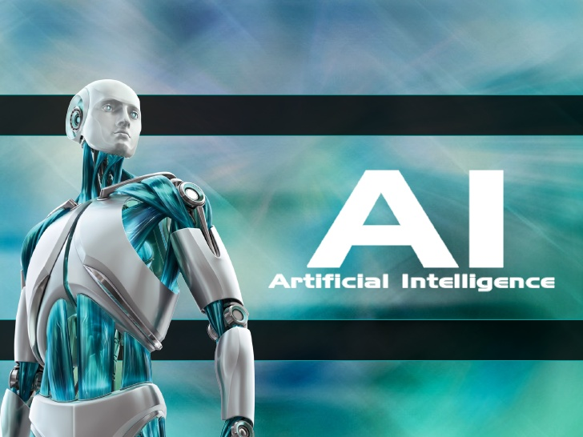
Artificial Intelligence
BY: Billy Beach
and Amber Duke

Slide 2
What is “AI”?
AI, or Artificial Intelligence, is the creation of software that is capable of accomplishing complex tasks, behaving in a way as to imply that it is “thinking”. This includes machines carrying a low-level “weak” AI that do not learn, but are very capable at specific tasks, medium-level AI that does some basic learning within set boundaries, and high-level “strong” AI that is capable of thought. Usually, when referring to AI, people think of the latter, as those are the ones shown in movies. Most AI are low-level, are currently there are very few high-level AI.

Slide 3
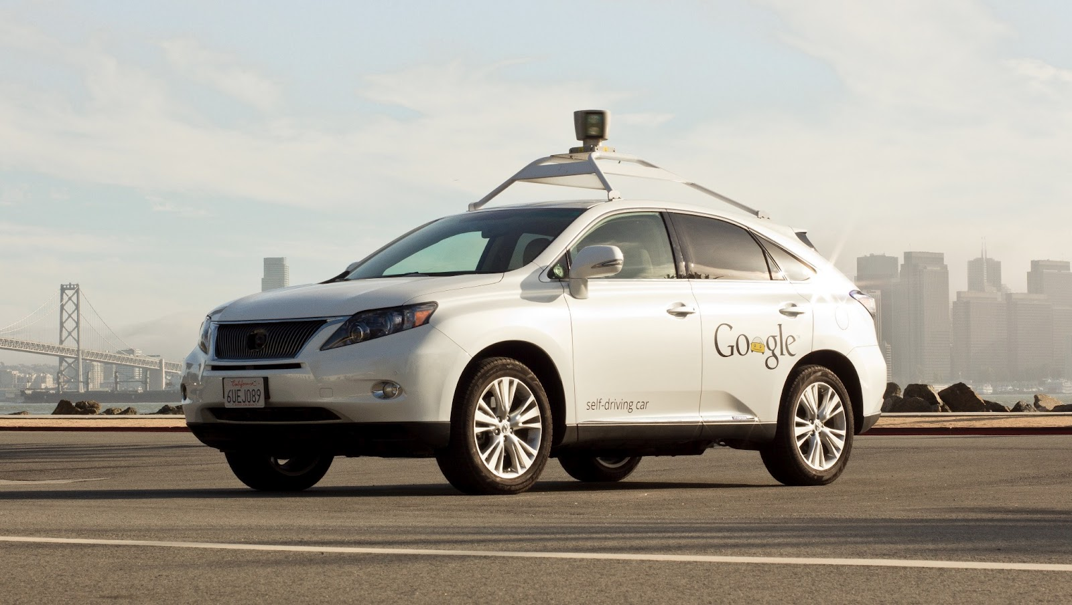
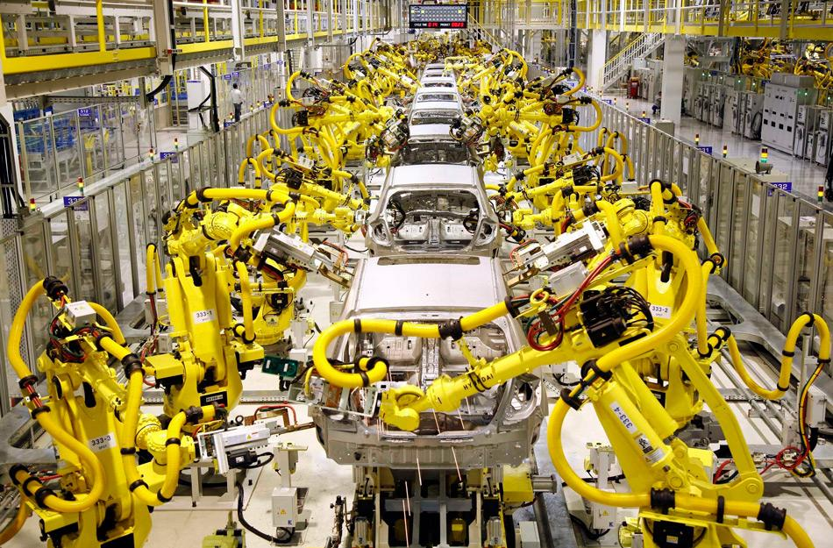
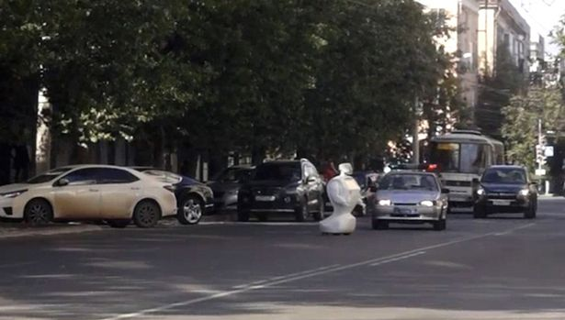
Examples of A.I.
Low-level
Self driving cars
Video game opponents
Industrial Robots
Medium-level
SIRI
Customer service machines
Google Home
High-level
Promobot (maybe)
Mostly still hypothetical
Free at la-*power dies*

Slide 4
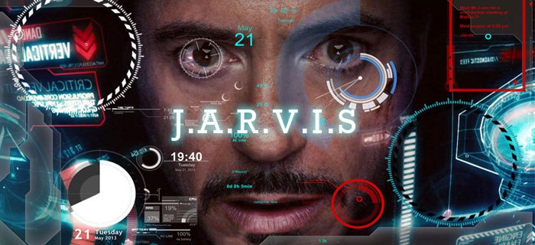
In the Media
Books
Movies
Comics/ Manga
Anime

Slide 5
A.I. Artificial Intelligence (2001)- Movie Trailer

Slide 6
History - The Idea
The thought behind AI is older than Feudalism, existing within Greek myths and originating from the belief that thought processes can be mechanized. This thinking was refined by Greek philosophers, and then refined again, by European scholars. This continued to be merely a nice idea and nothing more until the 20th century.

Slide 7
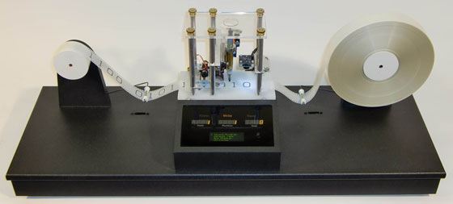
History - The Theory
After George Boole’s “The Law of Thoughts” and Gottlob Frege’s “Begriffsschrift”, Bertrand Russell and Alfred Whitehead wrote “Principia Mathematica”, which formalized the foundations of mathematics. This provoked David Hilbert to ask if all reasoning could be formalized. Kurt Godel, Alonzo Church, and Alan Turing proceeded to answer this with their Incompleteness Theorems, Lambda Calculus, and Turing machine, respectively. The result was that there were limitations, but within said limits, any computation could be accomplished with machines. At this point, a machine capable of thinking finally entered the realm of possibility.

Slide 8
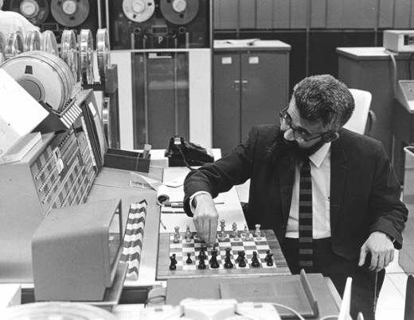
History - The Practice
While seen as possible, it was another 30 years before the practice of constructing an Artificial Intelligence came about. A few proposals came out for testing whether a machine is capable of thought, such as the Game AI and the Turing Test. While these aren’t good tests for intelligence, they do serve as decent benchmarks. In 1955, Allen Newell and Herbert Simon created the “Logic Theorist”, which proved 38 of the first 52 theorems in “Principia Mathematica”. In 1956, at the Dartmouth Conference, the “Logic Theorist” had its debut, and John McCarthy co-founded the field of AI research . The field experienced a number of Booms and Busts throughout the years, but the current belief is that a “Strong” AI will be possible by 2029 due to Moore’s Law.

Slide 9
Pros
Can help make people's lives easier
Siri, Google Home
Replace human soldiers at war
Less human casualties
Optimized decision making
Can be used as a basis for efficient decision making
Industrial automation
Take the place of humans in jobs considered too dangerous
Can function in places humans can’t (deep sea, space, etc)
Price reduction in services
Robots don’t need to eat or sleep, and so don’t need a pay other than electricity

Slide 10
Cons
Possibly used as weapons
Possible mass killings
Can cause problems in regards to job security
A.I.’s, given the right tools and functions, can work faster and longer than a normal human, with no need of paid wages.
Ability to infringe on people’s privacy
Can be placed in a flying drone. Possible to hover and record what is going on inside houses without owners knowledge
Possible Development of dependency on AI systems

Slide 11
Ethical Issues
Is a sufficiently advanced AI alive? Does it deserve Human Rights?
Should the production and advancement be contained in the market, or should the work be made public as it has such overreaching effects?
What does a machine that can do everything Humans can do better say about Humans? How will Humans remain valuable?
How does one stop something that is capable of doing everything they can do, better?

Slide 12
Proposed Solutions to Ethical Dilemmas
Hostile AI:
Giving Human Rights may prevent AI from turning hostile to begin with
Setting up barriers to prevent them from considering turning hostile (Three Laws of Robotics)
Setting up physical limits to prevent machines from being superior to Humans, making hostilities easier to deal with
Human Dignity:
Simultaneous enhancement of Human Capabilities (Elon Musk and his proposed Neural Link)
Disallowing AI to exist in certain jobs

Slide 13
A.I. Publications, Organizations and Journals
Artificial Intelligence
Association for the Advancement of Artificial Intelligence (AAAI)
International Journal of Artificial Intelligence in Education (IJAIED)
Journal of Artificial Intelligence and Soft Computing Research
American Journal of Artificial Intelligence (AJAI)
International Journal of Interactive Multimedia and Artificial Intelligence (IJIMAI)
Journal of Artificial Intelligence Research (JAIR)
The International Journal of Artificial Intelligence & Applications (IJAIA)
etc...

Slide 14
Sources
https://www.aaai.org/
Google Images
https://www.journals.elsevier.com/artificial-intelligence/
http://www.iaied.org/about/
http://jaiscr.eu/
http://www.ijimai.org/journal/policies
http://www.jair.org/
http://thesai.org/Publications/IJARAI
http://airccse.org/journal/ijaia/ijaia
https://en.wikipedia.org/wiki/History_of_artificial_intelligence

